Slide 1
TWEESENT
By:
NameTerror

Slide 2
Sentiment Analysis
Sentiment analysis (also known as opinion mining) refers to the use of natural language processing, text analysis and computational linguistics to identify and extract subjective information in source materials.
Consumers can use sentiment analysis to research products and services before a purchase. Production companies can use the public opinion to determine acceptance of their products and the public demand. Movie-goers can decide whether to watch a movie or not after going through other people’s reviews.

Slide 3
Twitter Sentiment Analysis
Traditionally, most of the research in sentiment analysis has been aimed at larger pieces of text, like movie reviews, or product reviews. Tweets are more casual and are limited by 140 characters.
However, this alone does not make it an easy task (in terms of programming time, not in accuracy as larger piece of text tends to be correctly classified) as people rarely give a second thought before posting a tweet. Grammar and content both suffer at the hands of the tweeter.
The presence of a large dataset is always recommended (for better training of the classifier) and twitter makes it possible to obtain any number of tweets during a desired period. However, various difficulties are faced during processing of raw tweets. (Discussed in coming slides)

Slide 4
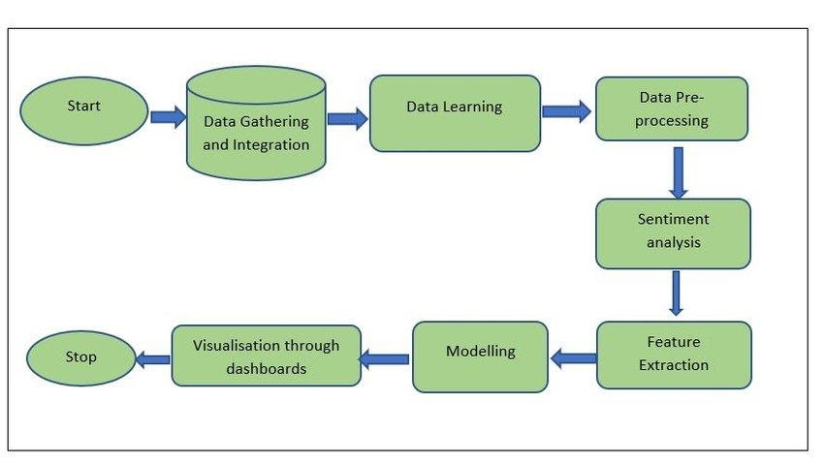
Flowchart

Slide 5
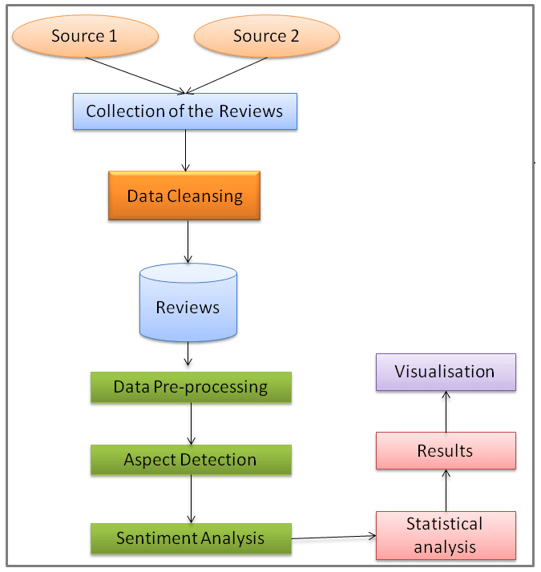

Slide 6
Literature Survey
Existing Problem
Along with the Corona virus pandemic, another crisis has manifested itself in the form of mass fear and panic phenomena, fuelled by incomplete and often inaccurate information. There is, therefore a tremendous need to address and better understand COVID-19's informational crisis and gauge public sentiment, so that appropriate messaging and policy decisions can be implemented. Impact of covid-19.

Slide 7
Proposed Solution
Sentiment Analysis is known as “Opinion Mining”, it refers to the use of Natural Language Processing to determine the attitude, opinions and emotions of a speaker, writer, or other subject within an online mention.
To study public sentiments, we chose Twitter as our target field. As one of the world’s biggest social network platforms, Twitter hosts abundant user-generated posts, which closely reflect the public’s reactions towards this pandemic with low latency. To build a predictive analytics model to understand the behaviour of people if new guidelines are introduced for example further extension of lockdown.
Also to develop a dashboard with visualization of people's reaction to the government announcements on lockdown extension.

Slide 8
Challenges
Usernames are mentioned more often than not. Usually they consist of some alphabets and numbers, and do not contribute much towards sentiment classification, except for increasing the size of the feature vector.
URLs too are not required in our task.
Repeated Letters People often repeat letters in some words, in order to stress upon a particular emotion. For example:- sad, saaaad, saaaddd. All of them mean the same, yet it is not possible to distinguish between them if guided only by their spellings.
Hashtags: Words in hashtags may be read different from the same word without the hash tag
Punctuations and additional spaces

Slide 9
Approach
Filtering for Feature Vector:
1) Stop words such as a, an, is, the, you, she, he, it, they, etc are removed as they do not indicate any sentiment.
2) Words starting with anything but alphabets were removed for simplicity sake.
3) Punctuation and repeating words were removed as they do not serve any purpose.

Slide 10
Naive Bayes Classifier
Naive Bayes is a simple technique for constructing classifiers: models that assign class labels to problem instances, represented as vectors of feature values, where the class labels are drawn from some finite set. All naive Bayes classifiers assume that the value of a particular feature is independent of the value of any other feature, given the class variable.

Slide 11
Maximum Entropy Classifier
The Maximum Entropy (MaxEnt) classifier is closely related to a Naive Bayes classifier, except that, rather than allowing each feature to have its say independently, the model uses search-based optimization to find weights for the features that maximize the likelihood of the training data.
The features you define for a Naive Bayes classifier are easily ported to a MaxEnt setting, but the MaxEnt model can also handle mixtures of boolean, integer, and real-valued features.

Slide 12
Support Vector Machines
A support vector machine constructs a hyperplane or set of hyperplanes in a high- or infinite-dimensional space, which can be used for classification, regression, or other tasks.
Intuitively, a good separation is achieved by the hyperplane that has the largest distance to the nearest training data point of any class (so-called functional margin), since in general the larger the margin the lower the generalization error of the classifier.

Slide 13
Future Scope
Sentiment Analysis will have a lot to do with social forums/platforms where
people express free opinion. Presently tweets are one such open medium, and then if face book at some point chooses to make the timeline updates/status messages open to search it will be gold mine of real-time sentiments. It is believed that the automatic sentiment analysis has a fair way to go before it can replace human coding of sentiment - though even human coding will have problems, as my idea of negative or somewhat negative may well be different from yours. It is known that machine learning techniques and sophisticated text analytics algorithms will be needed to improve the accuracy of automatic sentiment analysis. Sentiment analysis will only increase in importance as more and more people use online channels to communicate, both directly and
indirectly, with corporations.

Slide 14
Conclusion
Thus, Sentiment analysis has wide area of applications and it also facing many research challenges. Since the fast growth of internet and internet related applications, the Opinion Mining and Sentiment Analysis become a most interesting research area among natural language processing community. A more innovative and effective techniques required to be invented which should overcome the current challenges faced by Sentiment Analysis. Twitter analytical Dashboards ML insights can contribute and support local authorities to discover hidden trends and patterns learn critical factors and provide timely alternatives and perform powerful analysis and forecasting. It can help in saving days of manual investigation and analysis.

